Slide 1
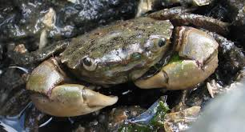

Testing the effects of predator presence and temperature on metabolic response in Hemigrapsus oregenensis
Joshua Johns, Brian Lam, Riley Matthiessen

Slide 2
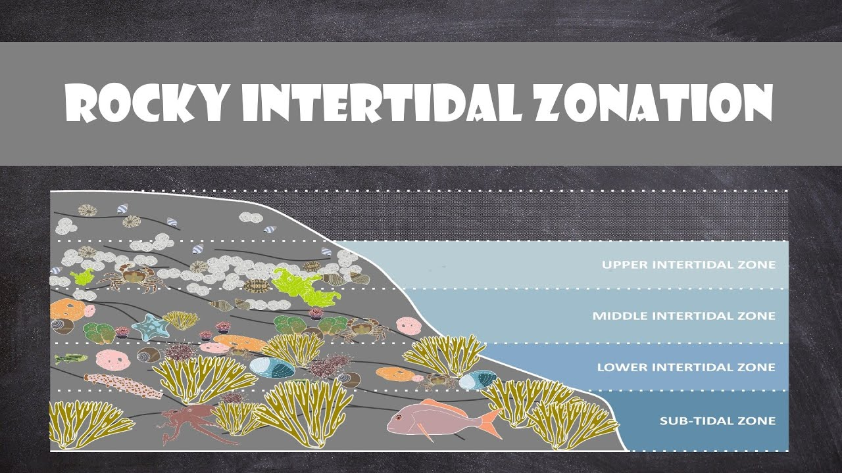
Introduction
Topic
Relevance
Study looks at how temperature and predator presence affects metabolism and behavior of Hemigrapsus oregonensis
Tested predator response for invasive Carcinus maenas
Intertidal systems are increasingly affected by multiple stressors
H. oregonensis can serve as a model for other crab species
Understanding native crab responses can be helpful for conservation and fishery management issues
Importance
Ocean warming may increase physiological stress for intertidal organisms
C. maenas is an invasive predator of concern for affecting native crab species

Slide 3
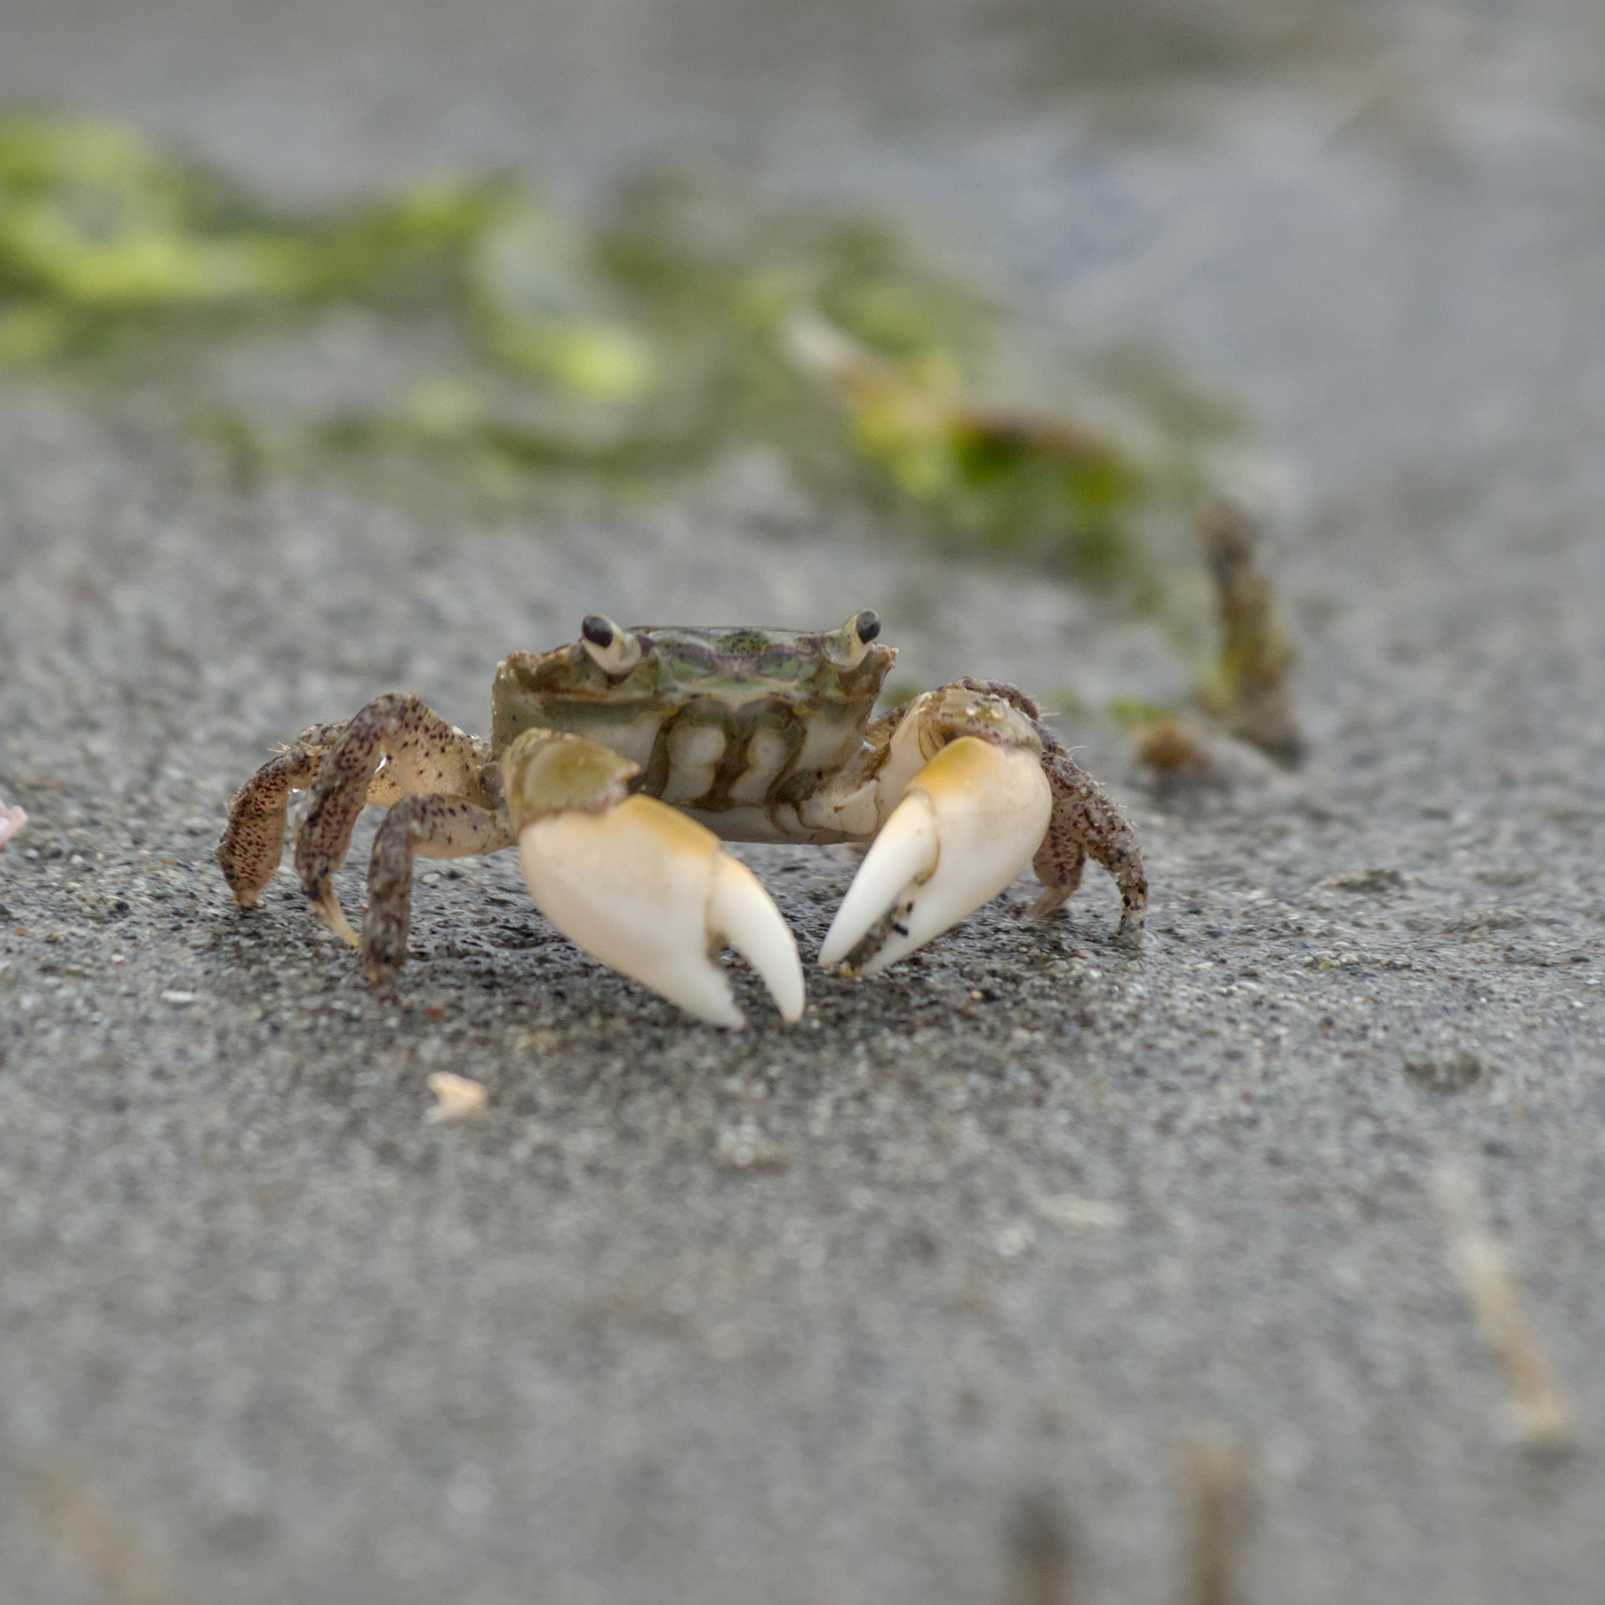
Background
Previous research shows that warming can increase metabolic demand in crabs (Newell, 1969)
Highly invasive predator Carcinus maenas is known to consume native shore crabs, including Hemigrapsus oregonensis (Jensen et al., 2002)
Predator cues can cause prey to reduce movement, hide more often, and spend less time feeding (Brown et al., 1999), while predation stress can increase metabolic rate (Clinchy et al., 2013)
These non-consumptive predator effects may reduce energy intake even when prey are not directly eaten (Brown et al., 1999; Clinchy et al., 2013)
Predator stress and warmer temperatures may both increase energetic costs, meaning higher metabolic rate
Notes:
Ecology of fear - causes behavioral changes like reduction in feeding, more hiding, avoiding exposed areas

Slide 4
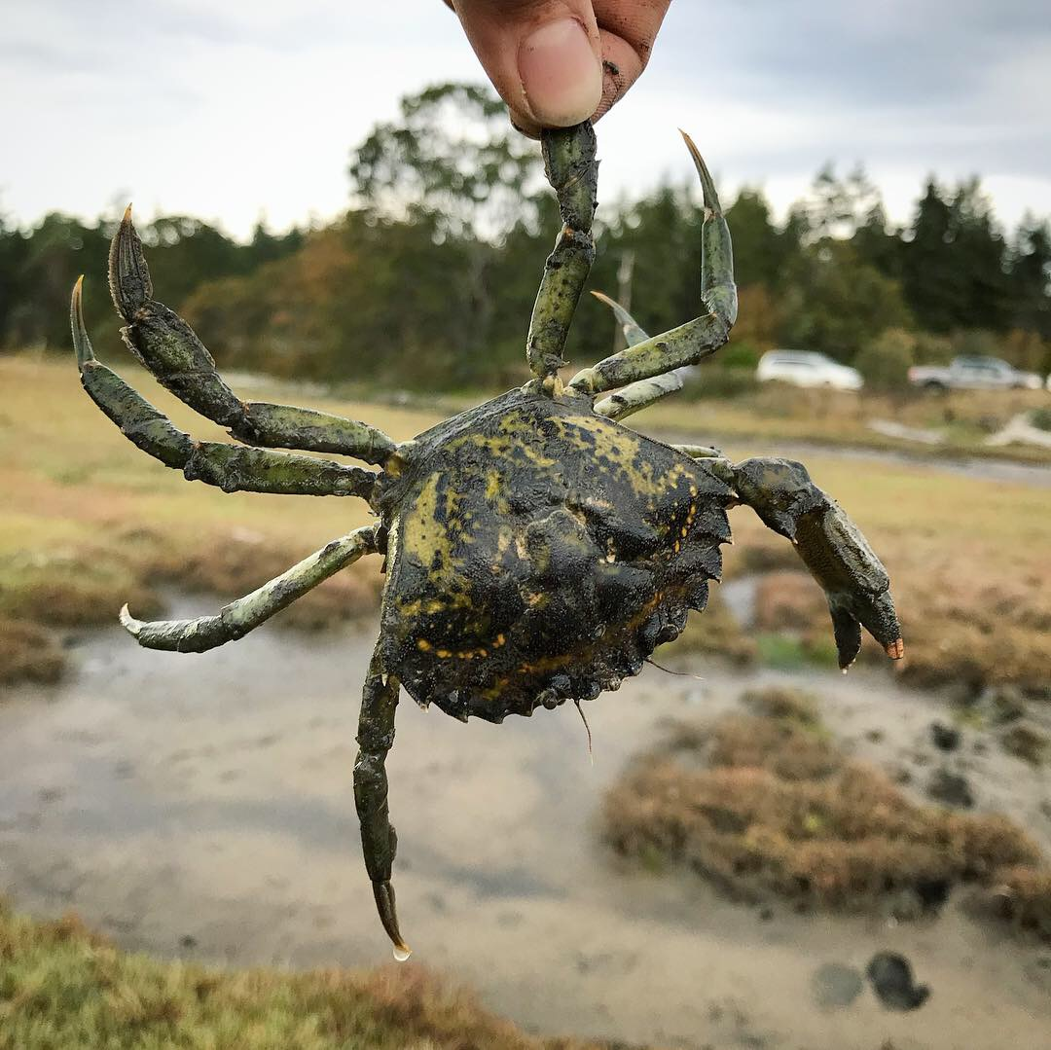
Research Question
How do the presence of predatory European green crabs (C. maenas) and changes in temperature affect the physiological and behavioral responses of Shore crabs (H. oregonensis) across three weeks?

Slide 5
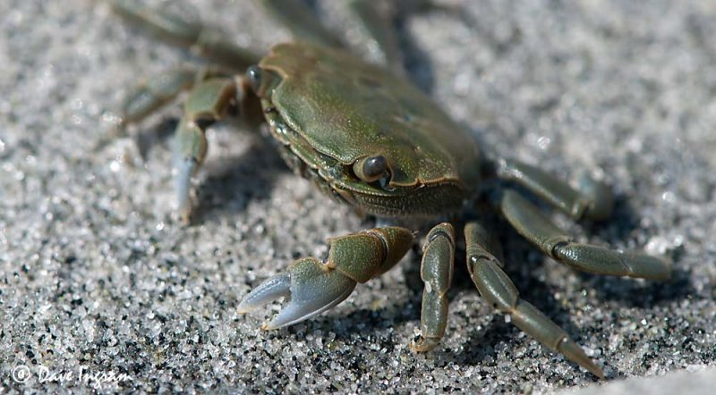
Hypothesis
Feeding time:
Ho: There is no difference in feeding time across treatments over the weeks.
Ha: Feeding time will decrease across predator treatments over the weeks.
Metabolic rate:
Ho: There is no difference in metabolic rate across treatments over the weeks.
Ha: Metabolic rate will increase across higher temperature treatments.

Slide 6
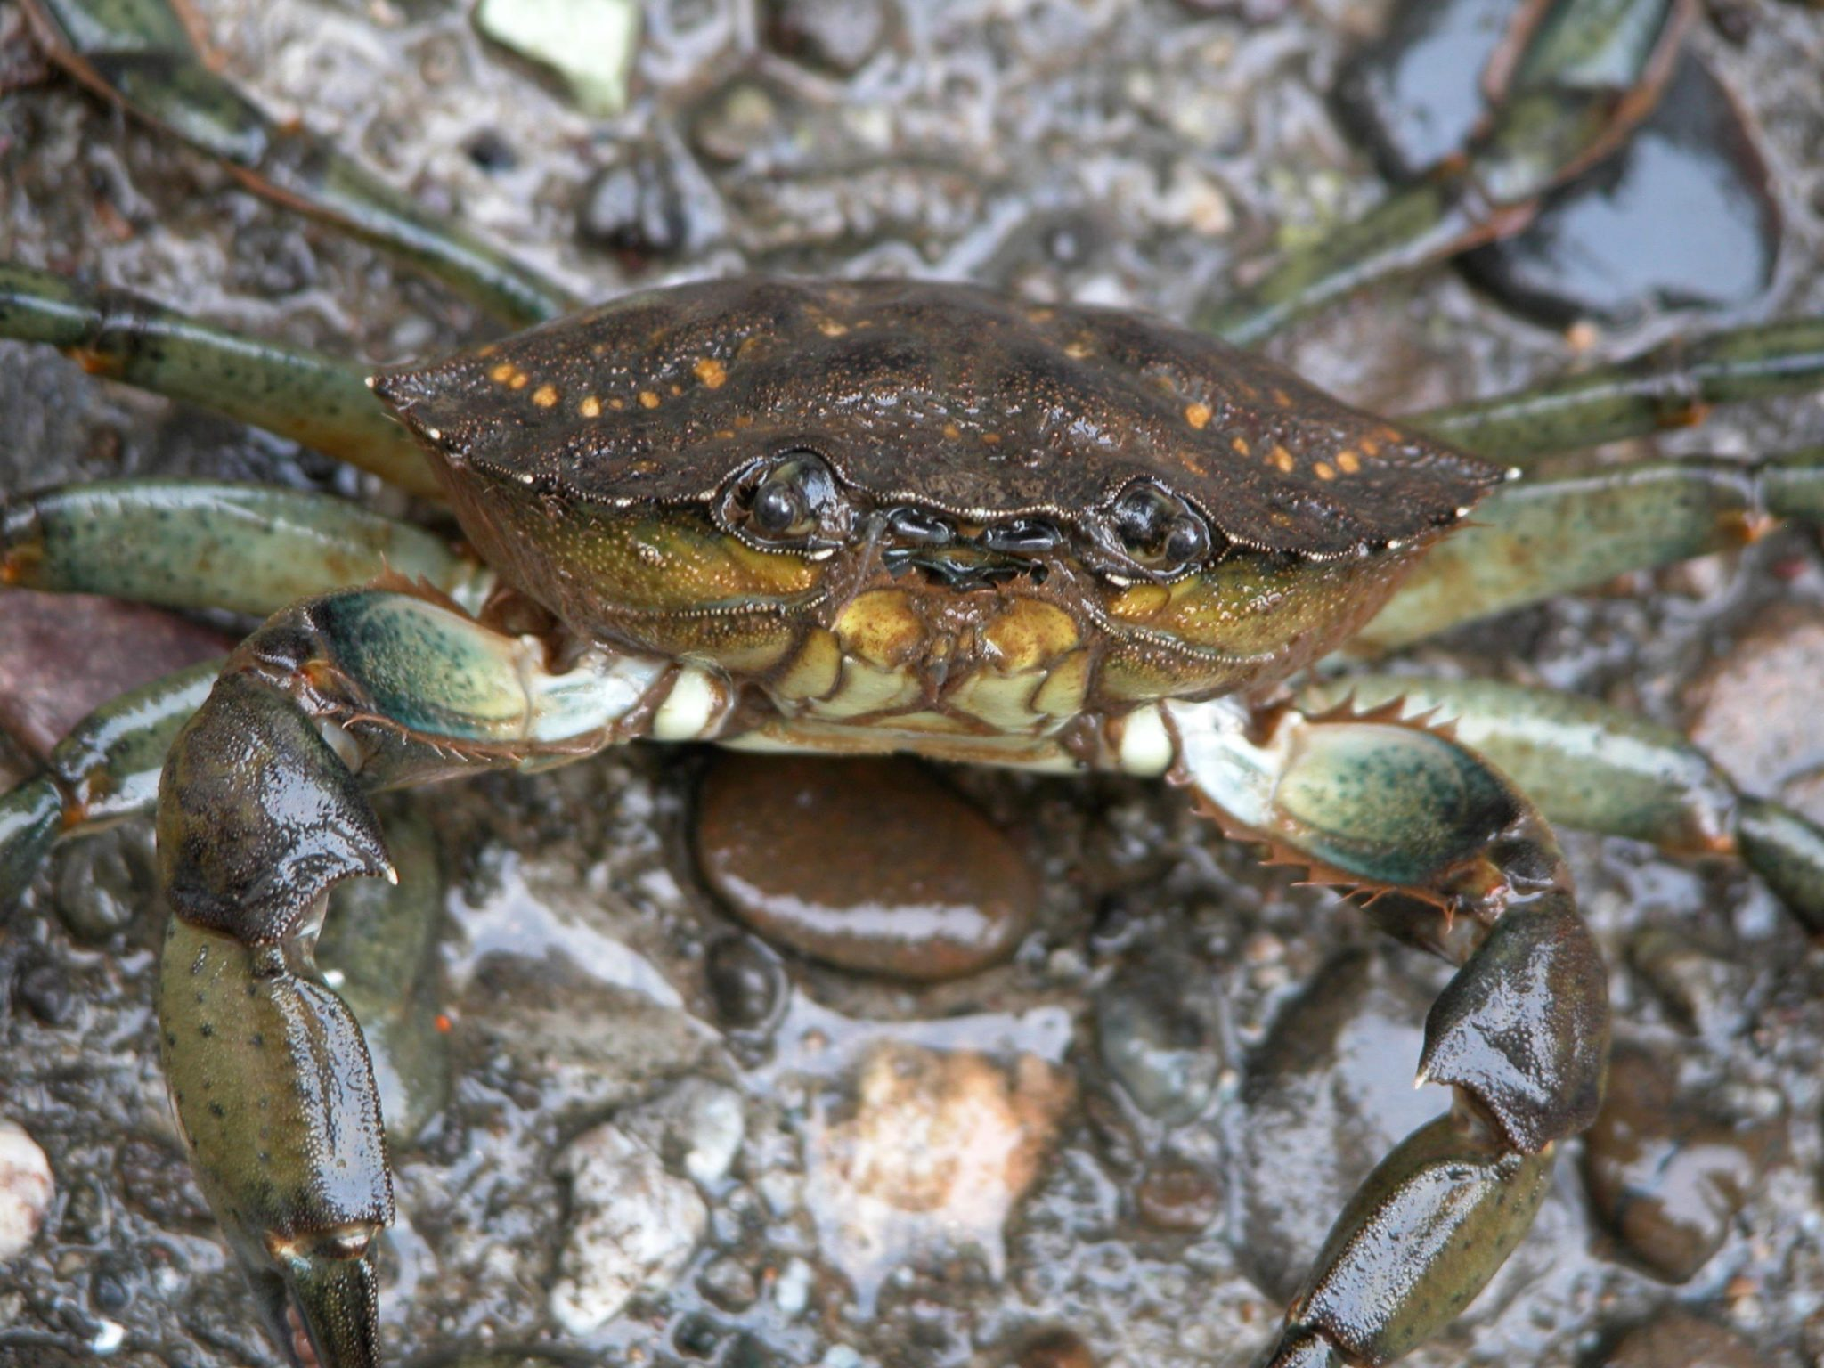
Experimental design
For the experimental set up we used crabs collected by our lab staff.
Four treatments
Substrate and dividers.
One European green crab (C. maenas) in the predator treatment.
Three Shore crab (H. oregonensis) each.
Feeding time, food consumption, and metabolic rate.

Slide 7
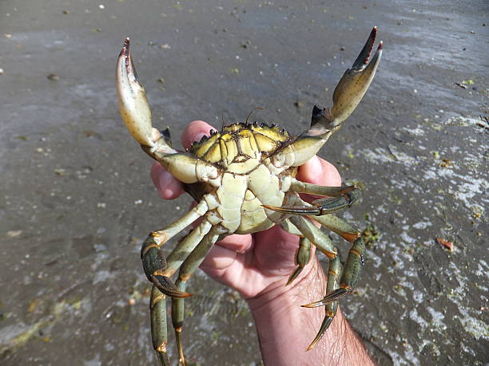
Methods
Feeding time when actively eating (in minutes).
The food was measured before and after, took the difference.
Average was taken across all treatments.
A total protein assay at the end.
Crabs deaths in week two and three.
Crabs replaced in week two.
Statistical test done with anova.

Slide 8
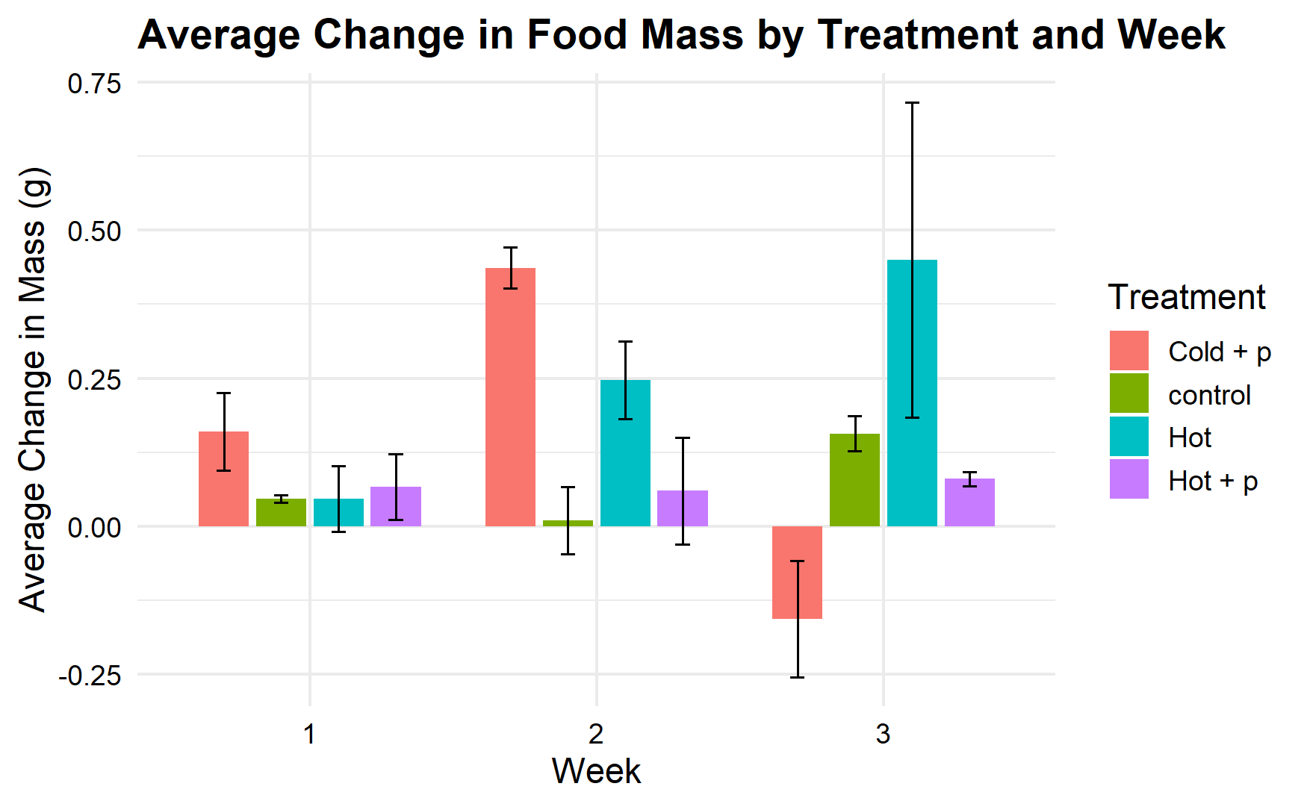
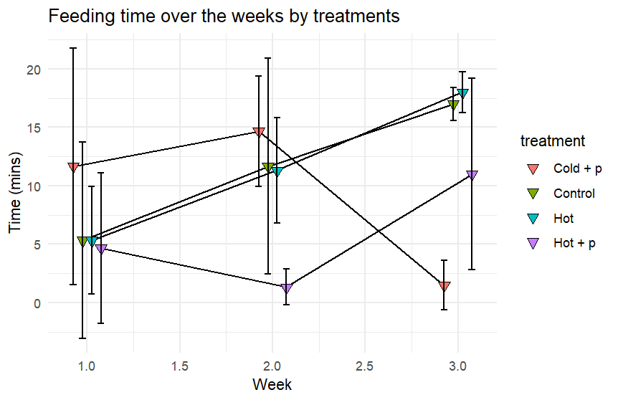
Results
Hot treatment increase
Small increase in control from week 1 to 2
Hot treatment remained stable
Cold w/ predator week 3 decrease
Increase in feeding time in hot and control treatments
Fluctuation in predator treatments
Week 3 cold w/ predator decrease

Slide 9
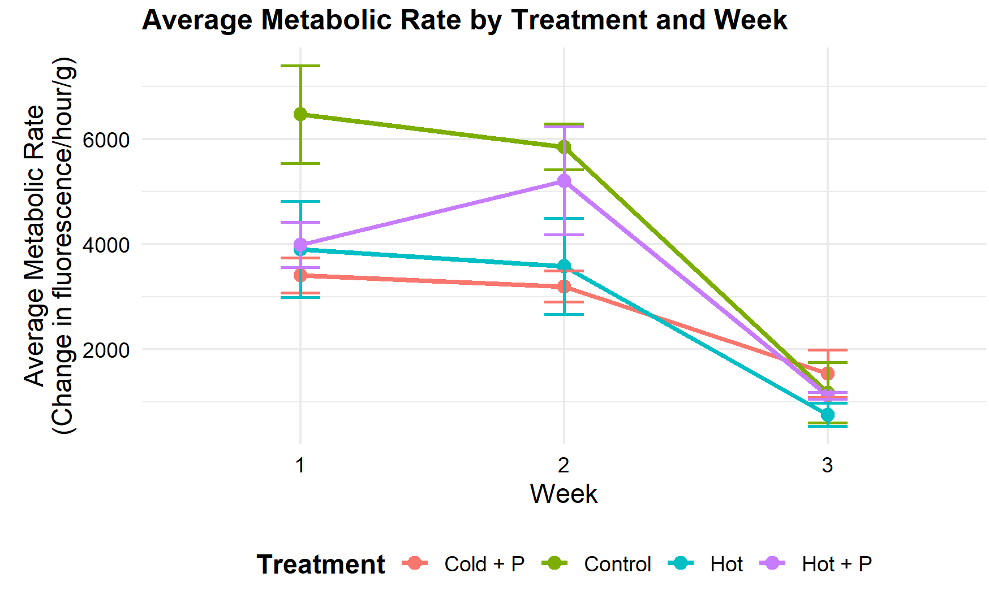
Results
All treatments showed decline in average metabolic rate over the study
Smaller decline from week 1-2, sharp decline from week 2-3
Control treatment started week one with the highest average metabolic rate
Week 2 Hot w/ predator increase

Slide 10
Discussion
Average feeding time did not appear to be directly correlated with average change in mass
Predator presence appeared to have an impact on feeding time with more time spend feeding in treatments without predators
Hot treatment feeding time and change in mass displayed a similar pattern
Control treatment did not
High variability within data sets makes it difficult to draw strong conclusions

Slide 11
Future work
Lab experiments
Increase sample size: less variability, less impact from replacing crabs lost to mortality, better define relations between predator presence, temperature and feeding
Add additional thermal treatments
Increase accuracy of feeding timing
Field work
Observe non-trophic interactions between green crabs and shore crabs in the wild
Further research
Research into interactions with other native species

